Slide 1
Python
Part 1

Slide 2
In the “Interpreter”
>>> print(“My code goes next to the carrots”)
My code goes next to the carrots
>>> print(“The output goes in a new line”)
The output goes in a new line

Slide 3
Elementary, my dear Python
>>> 5 + 4 - 1
8
>>> 6 / 4
1.5
>>> 5 * 4
20
>>> 14 % 5
4
>>> 6 // 4
1
>>> 3 ** 3
27
*In Python 2.7, both / and // are floor divide. (ew)

Slide 4
Assigning a variable
>>> my_variable = 14
>>> my_variable
14
>>> foo = 1
>>> my_variable + foo
15
Setting the value of my_variable to 14, setting the value of foo to 1.

Slide 5
>>> bar = 5
>>> bar = 6
>>> bar / 2
3
>>> bar
6
Performing an elementary operation on a variable assigned to a number does not change the value of the variable

Slide 6
A useful operation
>>> counter = 3
>>> counter += 1
>>> counter
4
>>> counter -= 1
counter
3
+= or -= do two things: They perform an addition/subtraction on the variable, then set the variable to that new value!
How could this be useful?

Slide 7
Strings
>>> name = “Steven”
>>> name + “ is a pretty cool guy”
‘Steven is a pretty cool guy’
>>> print(name)
Steven
Variables can be assigned to words as well! They are called ‘strings’, and are surrounded by “ or ‘

Slide 8
Some Utilities (Strings)
s[1:]
s[:-1]
s + x
x in s
x not in s
s[n:k]
“All but first”
“All but last”
“Add x to the end of s”
True if chars of x appear in order in s
False if chars of x appear in order in s
char n to char k not including char k from s

Slide 9
Booleans and Logic
>>> 5 == 5
True
>>> 5 != 5
False
>>> 5 < 4
False
>>> True and False
False
>>> True or False
True
>>> not True
False

Slide 10
If / Elif / Else
>>> if 9 == 5:
... print(“if case”)
... elif 47 <= 47:
... print(“else if case”)
... else:
... print(“else case”)
...
else if case

Slide 11
Your friend, the while loop
>>> while <this is true>:
... <do some stuff>
... <get closer to stopping loop>
The ‘while loop’ will repeat until the <this is true> condition becomes false.

Slide 12
A quickie
>>> count = 1
>>> python = ‘revolutionary’
>>> while count < 4:
... python += ‘!’
... count += 1
...
>>> python
‘revolutionary!!!’

Slide 13
Defining Functions
It’s easy to write functions in Python! “def” followed by your function’s name, followed by (your variables): will get you started!
>>> def my_func(x, y):
... return x * y
...
>>> my_func(5, 6)
30

Slide 14
A note on Indentation
Indents (4 spaces) are important in Python when they are preceding statements.
>>> def exclaimer(word):
... for i in range(1, 3):
... k = 1
... while k < 4:
... word = word + ‘!’
... k = k + 1
... return word
Think of it like nesting in Snap!

Slide 15
If / Else and Indentation
>>> cookie = “delicious”
>>> if len(cookie) == 9:
... print(exclaimer(cookie))
... else:
... print(‘not 9 characters’)
...
delicious!!!!!!

Slide 16
To the Prompts!
>>>

Slide 17
Greetings!
def greet(name):
“””Give a greeting.
>>> greet(“Johnny”)
Hello Johnny
”””

Slide 18
Greetings!
def greet(name):
print(“Hello ” + name)

Slide 19
Factorial (again…):
def factorial(x):
“””Return the factorial of x.”””

Slide 20
Factorial (again…):
def factorial(x):
if x == 1:
return 1
else:
return x * factorial(x - 1)
>>> factorial(5)
120

Slide 21
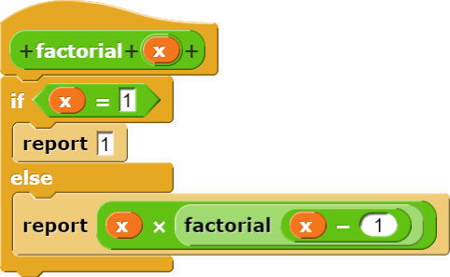
Factorial (Snap!):

Slide 22
Has seven?
def has_seven(n):
“““Given a number n, return whether any of its digits is a 7.
(hint: floor division and modulo might be helpful)
”””
>>> has_seven(45)
False
>>> has_seven(20178)
True

Slide 23
Has seven?
def has_seven(n):
if n % 10 == 7:
return True
elif n == 0:
return False
else:
return has_seven(n // 10)
>>> has_seven(453)
False
>>> has_seven(979)
True

Slide 24
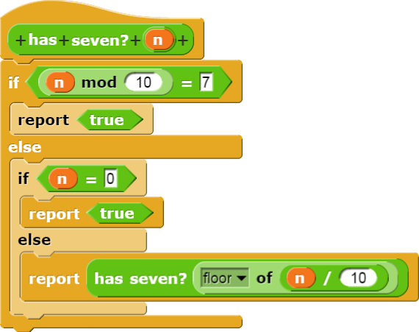
Has seven (Snap!)?

Slide 25
Every other character in string
def every_other(string):
“””Given a string, return a new string with only every other character of the original.”””

Slide 26
Every other character in string
Notice that “i” here represents the index in the string
def every_other(string):
output_string = “”
for i in range(len(string)):
if i % 2 == 0:
output_string = output_string + string[i]
return output_string

Slide 27
Factorion
def is_factorion(n):
“””Return whether the sum of the factorials of n’s digits add up to n.
(hint: floor division and modulo might be
helpful) ”””
# The ‘#’ is used to create one-line comments.
# You can assume factorial(n) is already written.

Slide 28
Factorion - Recursive
def is_factorion(n):
return n == calc_factorion(n)
def calc_factorion(n):
if n == 0:
return 0
return calc_factorion(n//10) + factorial(n%10)

Slide 29
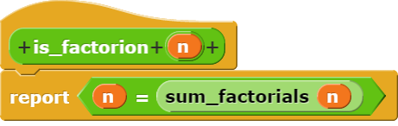
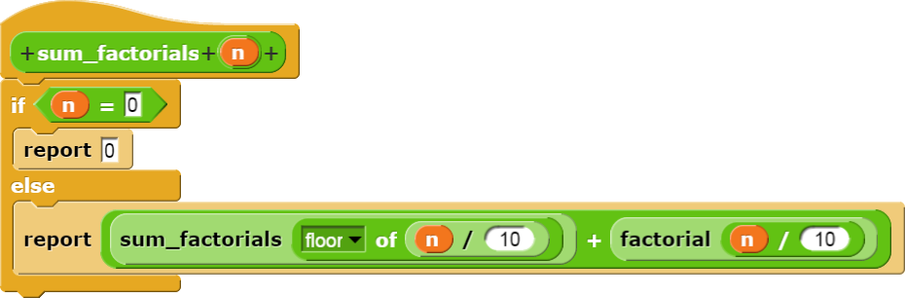
Factorion - Recursive

Slide 30
Factorion - Iterative
def iter_factorion(n):
result = 0
x = n // 10
y = n % 10
while not(x==0 and y==0):
result += factorial(y)
y = x % 10
x = x // 10
return n == result

Slide 31
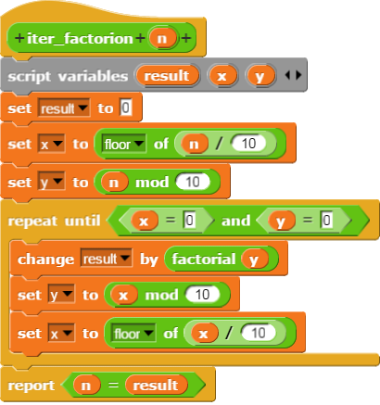
Factorion - Iterative

